Slide 1


Trend Analysis and Forecasting
Tribal Gaming Exclusivity Fees in Oklahoma
Sai Srivatsa Thangallapelly

Slide 2

Abstract
This study analyzes tribal gaming exclusivity fees in Oklahoma from 2006 to the present, employing advanced statistical methods to uncover trends and forecast future revenues. Utilizing Support Vector Regression, Random Forest, and Gradient Boosting Regression, we identified significant seasonal patterns and the impact of economic factors on revenue flows. Gradient Boosting Regression provided the most accurate forecasts. The findings offer valuable insights for policymakers and tribal officials, aiding strategic planning and resource allocation in the state.

Slide 3

Introduction
Importance of Tribal Gaming Exclusivity Fees:
Tribal gaming exclusivity fees are crucial for Oklahoma’s economy, significantly funding state needs like education and healthcare.
The sector boosts local economies, creating jobs and supporting tourism.
Objectives of Analyzing These Fees:
Trend Analysis: Identify historical trends in fee collections to understand their economic impact.
Forecasting: Predict future fee trends to enhance state budgeting and strategic planning.
Inform Policy: Provide insights to help policymakers and tribal officials make data-driven decisions regarding gaming regulations.

Slide 4


Problem Statement
The State of Oklahoma collects tribal gaming exclusivity fees from compacted tribes, granted the exclusive right to operate certain types of gaming activities. The dataset, which spans from 2006 to the present, provides a monthly record of these fees. The objective of this project is to analyze the financial trends in tribal gaming exclusivity fees over the years, identifying seasonal patterns, year-on-year growth or decline, and the impacts of external factors such as economic conditions or regulatory changes.

Slide 5

Data Description
Dataset Overview:
Source: Public records maintained by the State of Oklahoma.
Time Frame: Data spans from 2006 to the present, providing a comprehensive look at over a decade of exclusivity fees.
Format: Monthly records of tribal gaming exclusivity fees collected.
Key Variables:
Months (2006-2020): Each column from 2006 to 2020 represents exclusivity fees collected per month, reflecting changes and trends over time.
Exclusivity Fee Amounts: The values are recorded in U.S. dollars, indicating the amount paid by the tribes to the state government.
Data Structure:
Dimensions: 12 rows (months) and 16 columns (years from 2006 to 2020).
Type: Monthly data recorded annually per column, providing a structured timeline for analysis.

Slide 6
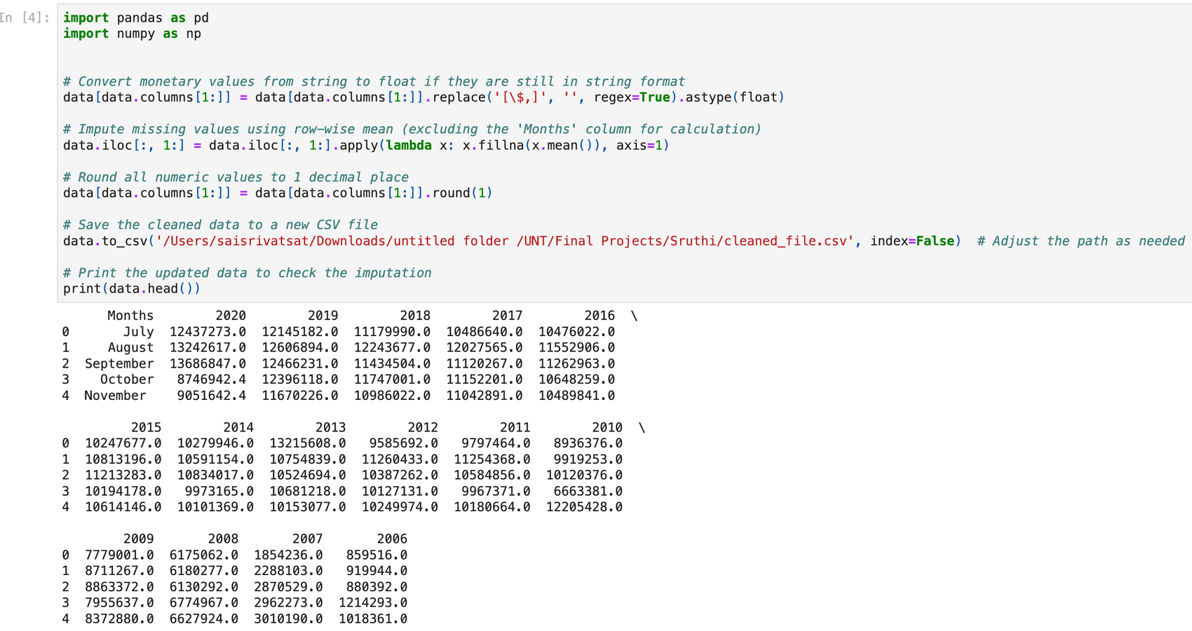
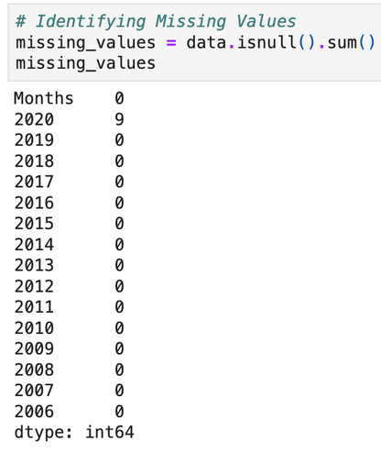
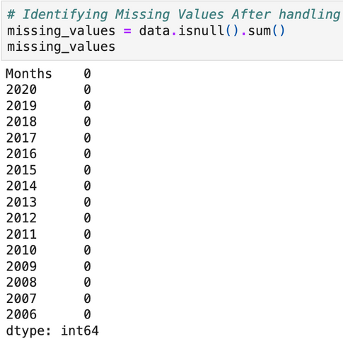
Data Cleaning and Preprocessing
Identifying Missing Data:
Initial analysis revealed missing values in the 2020 data.
No missing data detected for other years.
Handling Missing Data:
Row-wise Mean Imputation: Chosen due to its ability to maintain temporal consistency and statistical stability. It leverages the average conditions observed in the same months across different years.
Applied to the 2020 column where missing values were present.
Data Transformation:
Normalization: Fee amounts normalized for inflation to ensure consistent value representation across years.
Log Transformation: Applied to stabilize variance, enhancing the performance of subsequent predictive models.
Data Structuring:
Reshaping Data: Converted from a wide format (years as columns) to a long format to better facilitate time series analysis.
Enhanced the dataset structure for easier manipulation and analysis.

Slide 7
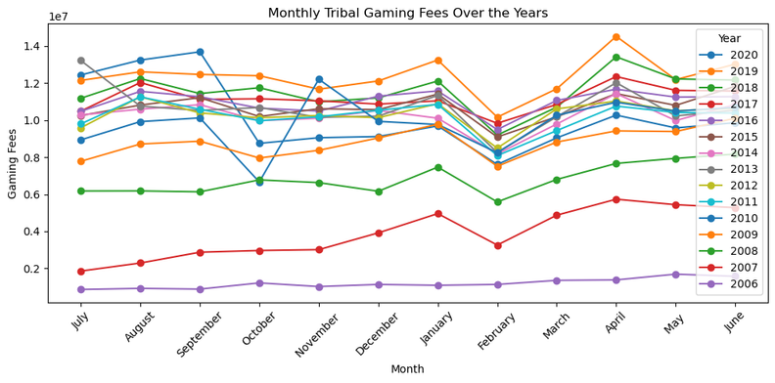
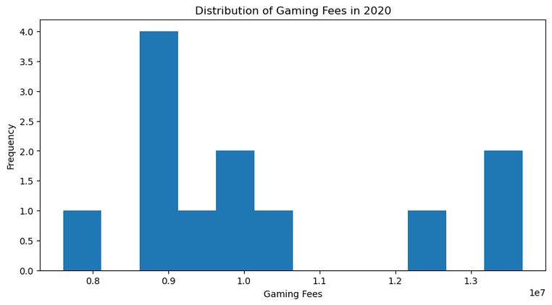
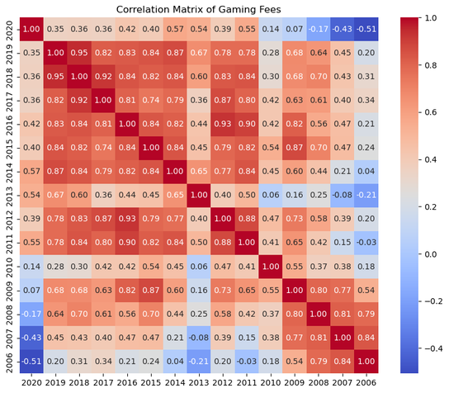
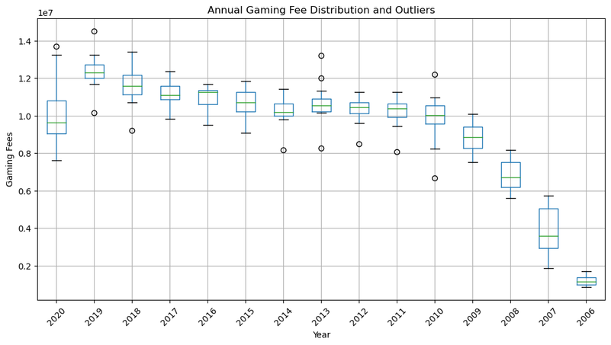
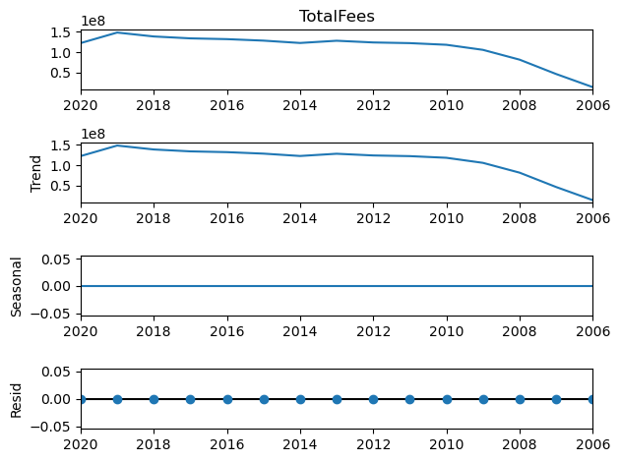
Exploratory Data Analysis (EDA)
Visualization of Data Trends
Histograms for Distribution Analysis
Box Plots for Outliers and Annual Comparison
Correlation Heatmap
Time Series Decomposition

Slide 8
Model Comparison
01. Support Vector Regression (SVR)
02. Random Forest Regression
03. Gradient Boosting Regression
MAE: 1,509,225.21
MSE: 3,555,166,982,024.28
R-squared: -1.78
Insight: Exhibits high errors and a negative R-squared, indicating poor fit and predictive performance worse than a naive mean model.
MAE: 1,438,431.02
MSE: 2,131,684,487,977.09
R-squared: -0.67
Insight: Shows improvement over SVR with lower errors, but still underperforms with a negative R-squared, suggesting it also fails to model the data effectively.
MAE: 443,599.97
MSE: 275,684,743,163.98
R-squared: 0.78
Insight: Provides the lowest error metrics and a positive R-squared, indicating a substantial proportion of variance explained and superior predictive accuracy.

Slide 9

Model Evaluation Summary:
01.
Gradient Boosting Regression is the clear frontrunner, significantly outperforming both SVR and Random Forest in all key metrics.
02.
Effectiveness: Gradient Boosting not only minimizes prediction errors but also captures a significant amount of variance, making it the most reliable choice for this dataset.

Slide 10
Conclusion
In this project, we aimed to enhance strategic decision-making and revenue forecasting for tribal gaming exclusivity fees in Oklahoma by employing advanced machine learning techniques. After evaluating several predictive models, including Support Vector Regression (SVR), Random Forest Regression, and Gradient Boosting Regression, we identified Gradient Boosting as the most effective, due to its superior accuracy and explanatory power. The insights derived from this model are poised to significantly benefit strategic planning and policy formulation, providing stakeholders with valuable foresight into future revenue trends. By adopting Gradient Boosting Regression and committing to continuous model refinement, organizations can ensure precise revenue forecasting, optimal resource allocation, and adaptability to evolving market dynamics. This project not only underscores the importance of data-driven decision-making but also demonstrates the transformative potential of predictive analytics in optimizing business outcomes within the gaming industry.

Slide 11

“Even if we don’t have the power to choose where we come from, we can still choose where we go from there.” — Stephen Chbosky

